Slide 1
Environment sensors
Zug can automatically sense the environment on which it is running.
  ZEnv_Sensor Molecule
  ZEnv_Values Context Variable

Slide 2
Environment sensors
ZEnv_Sensor molecule is defined with this name to sense the environment in which the tests are being run
User don’t have to call this Molecule.
Invoked implicitly after running the Init test case or after running the first test case of the test suite

Slide 3
Environment sensors
ZEnv_Values context variable is defined by ZUG to store some environment related information.
Initially ZUG populates it with the values of
  OS Name
  Java version
  LOGON SERVER
  COMPUTER NAME
  USER NAME
  APPDATA
  USERDOMAIN
  PROCESSOR_ARCHITECTURE
  NUMBER_OF_PROCESSORS
  RAM SIZE

Slide 4
Environment sensors
The values are stored as key=value pair and as a comma separated list i.e,
OS Name=Windows 7,Java Version=1.6,User Name=Ellora
Test Case designer can use this ZEnv_Values CV’s values inside the ZEnv_Sensor molecule.
Can further add some more details in the ZEnv_Values context variable in ZEnv_Sensor molecule which may be needed i.e, name and version of the browser.
These values can further be reported to the Test Management Frame work (Zermatt).

Slide 5
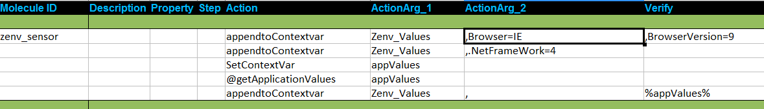
Example-Environment sensors

